Slide 1

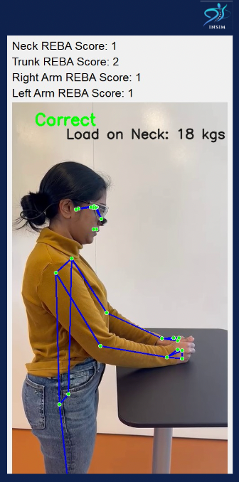

InSim Surgical:
Empowering surgeons through training for career excellence
Elakiya Sivakumar, Product Strategy Lead
InSim Surgical

Slide 2

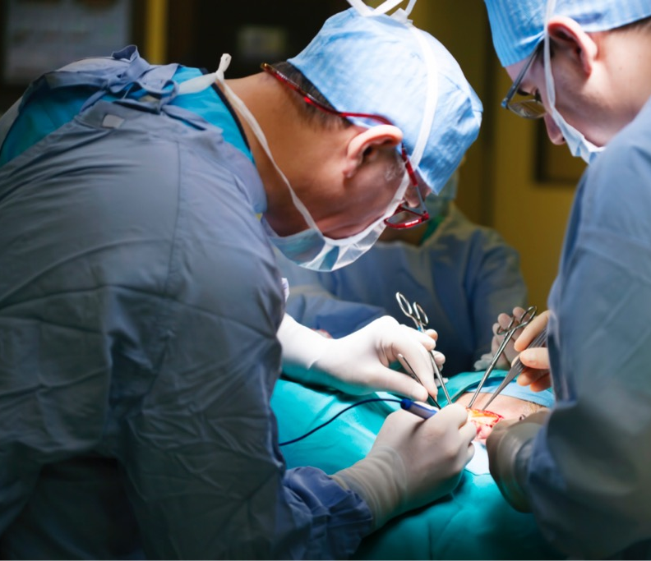
The Problem
Surgeons have the
Highest Rate of work-related Musculoskeletal Disorders
8 in 10 Surgeons experience chronic back/neck pain
>$15M Hospital expenditure for MSD-Sick leave & sabbaticals
>76% Surgeons report not having any ergonomic training
1 in 5 Surgeons plan to retire early as result of physical toll
Notes:
while we can’t change the duration of the surgery, we can train surgeons to prepare for these long, strenuous operations
1 in 5
Surgeons plan to retire early as result of physical toll

Slide 3
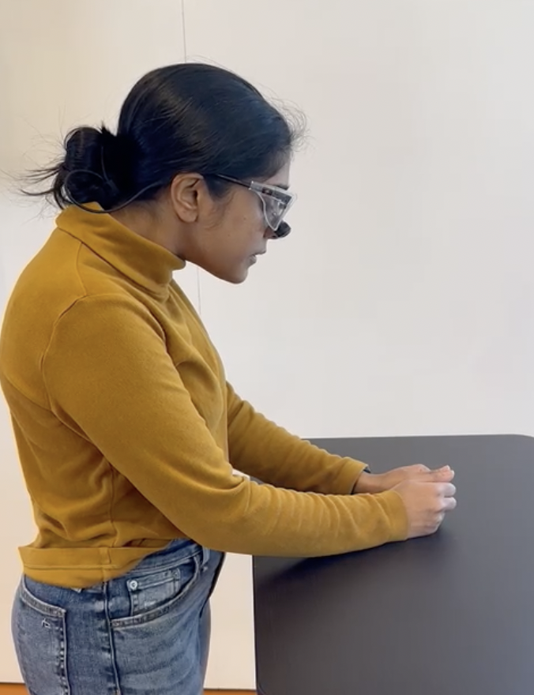

From Residency To Surgeon Attending
Cycle of Care & Unmet Need
Injury & MSD’s
Surgical training
Go home, rest
Operate for 4-12 hrs
Sabbatical
Stretch Pain Medication Physical Therapy
Bad posture
Pain after surgery
Frequent strain & pain
There is a need for a way to address lack of ergonomic surgical training for back posture in surgical residents to reduce MSD risk.

Slide 4
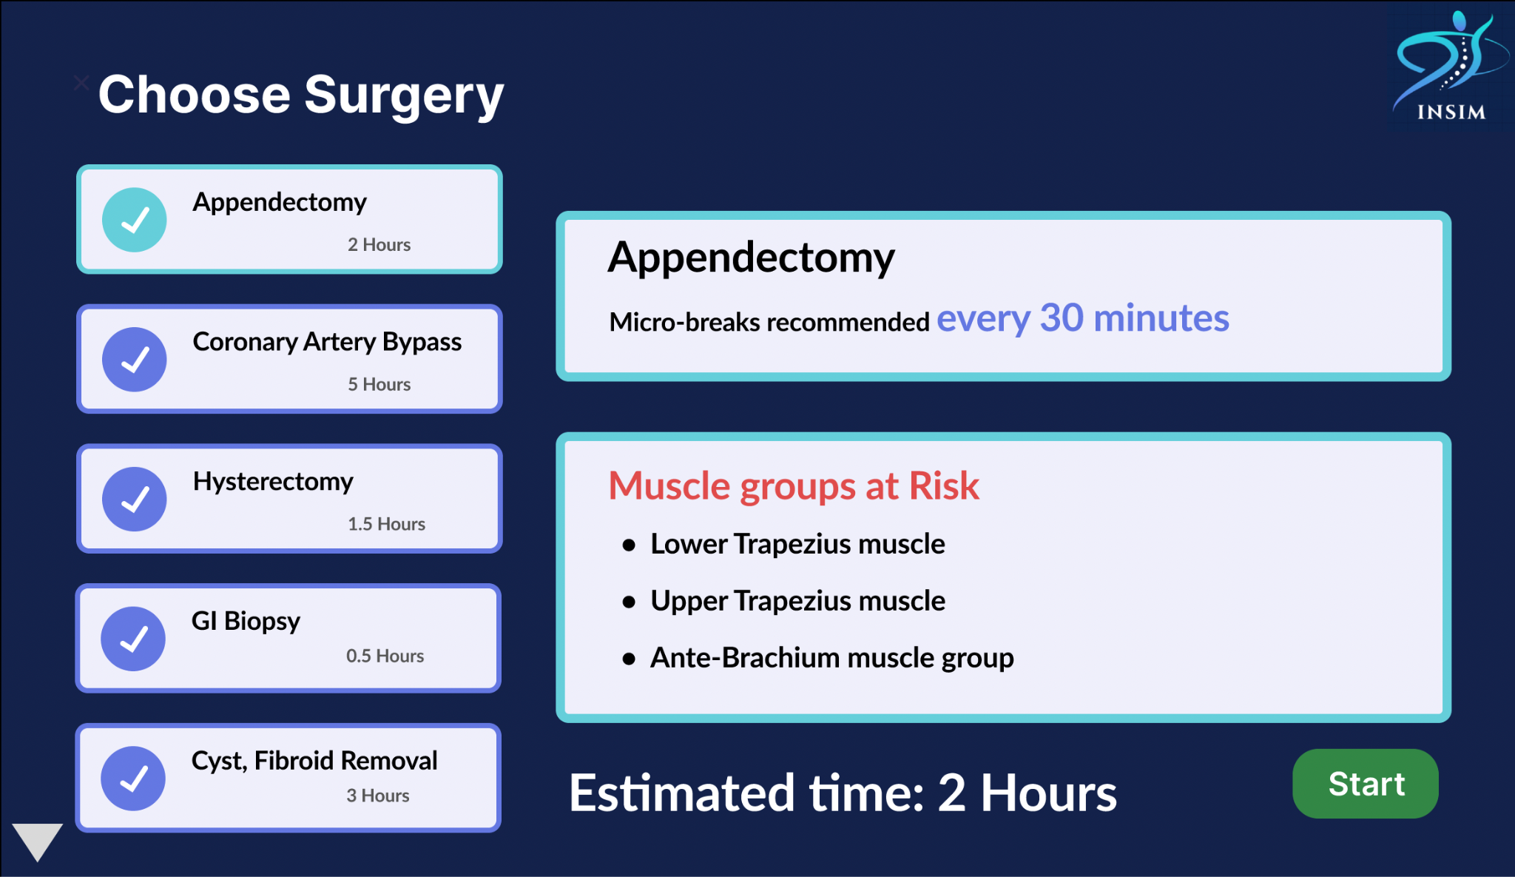
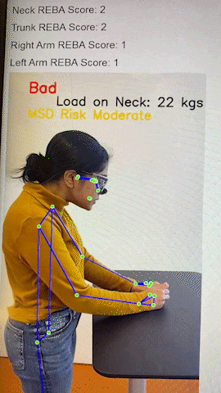

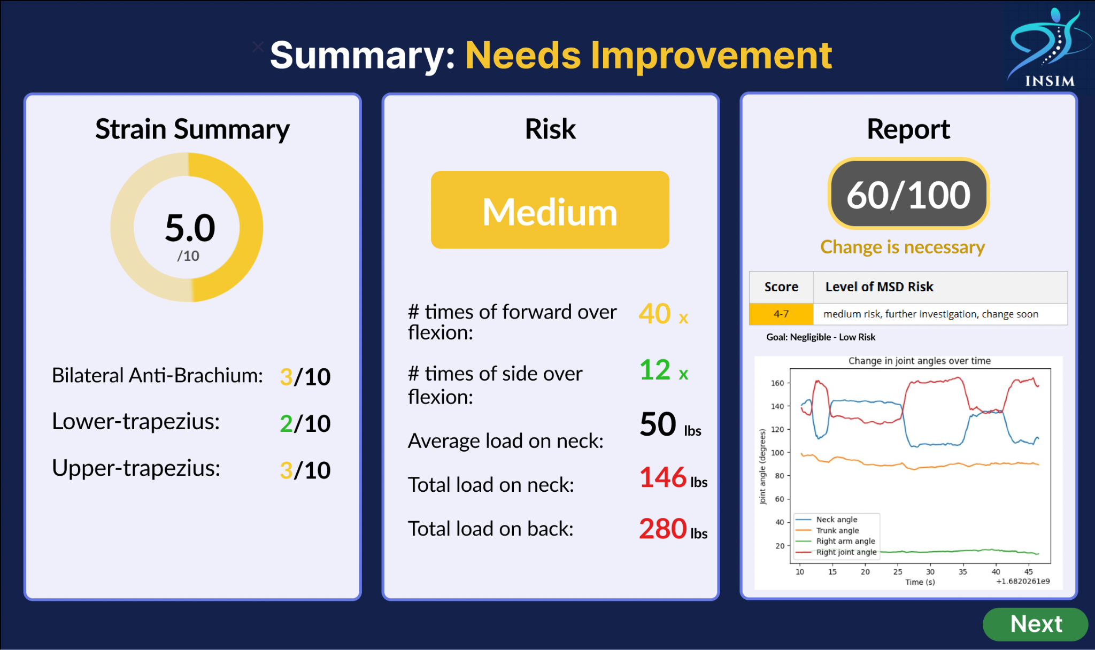
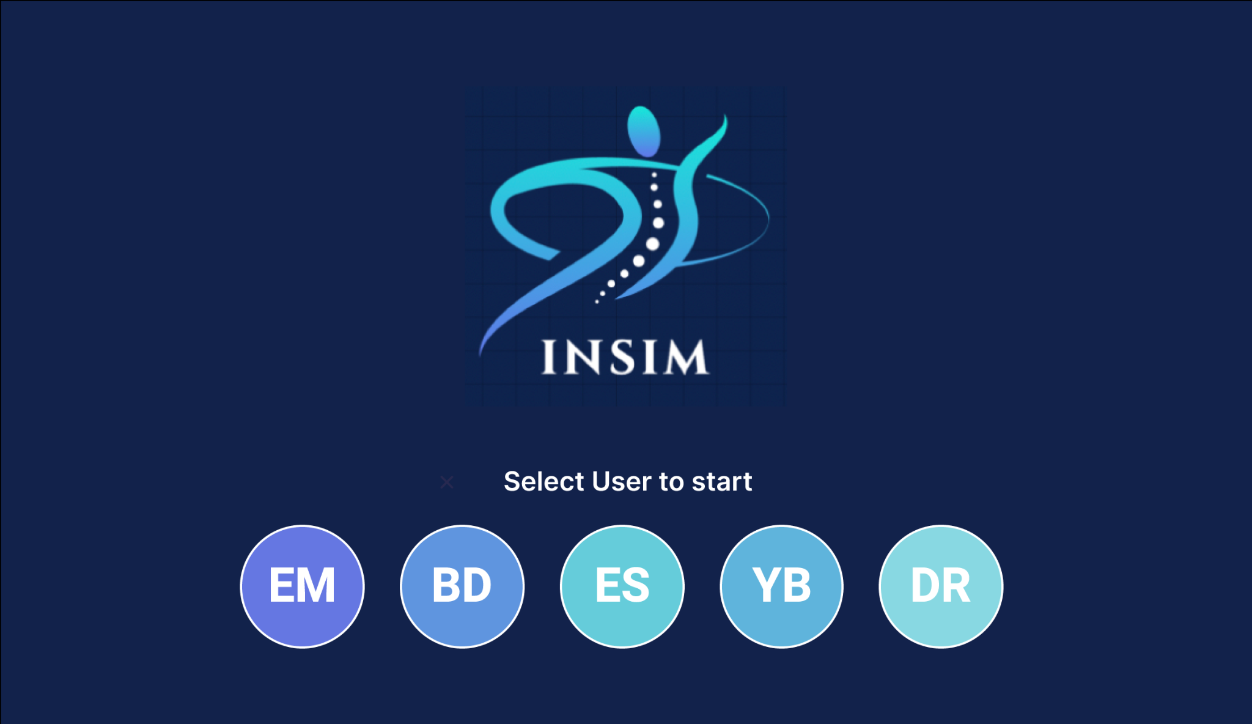
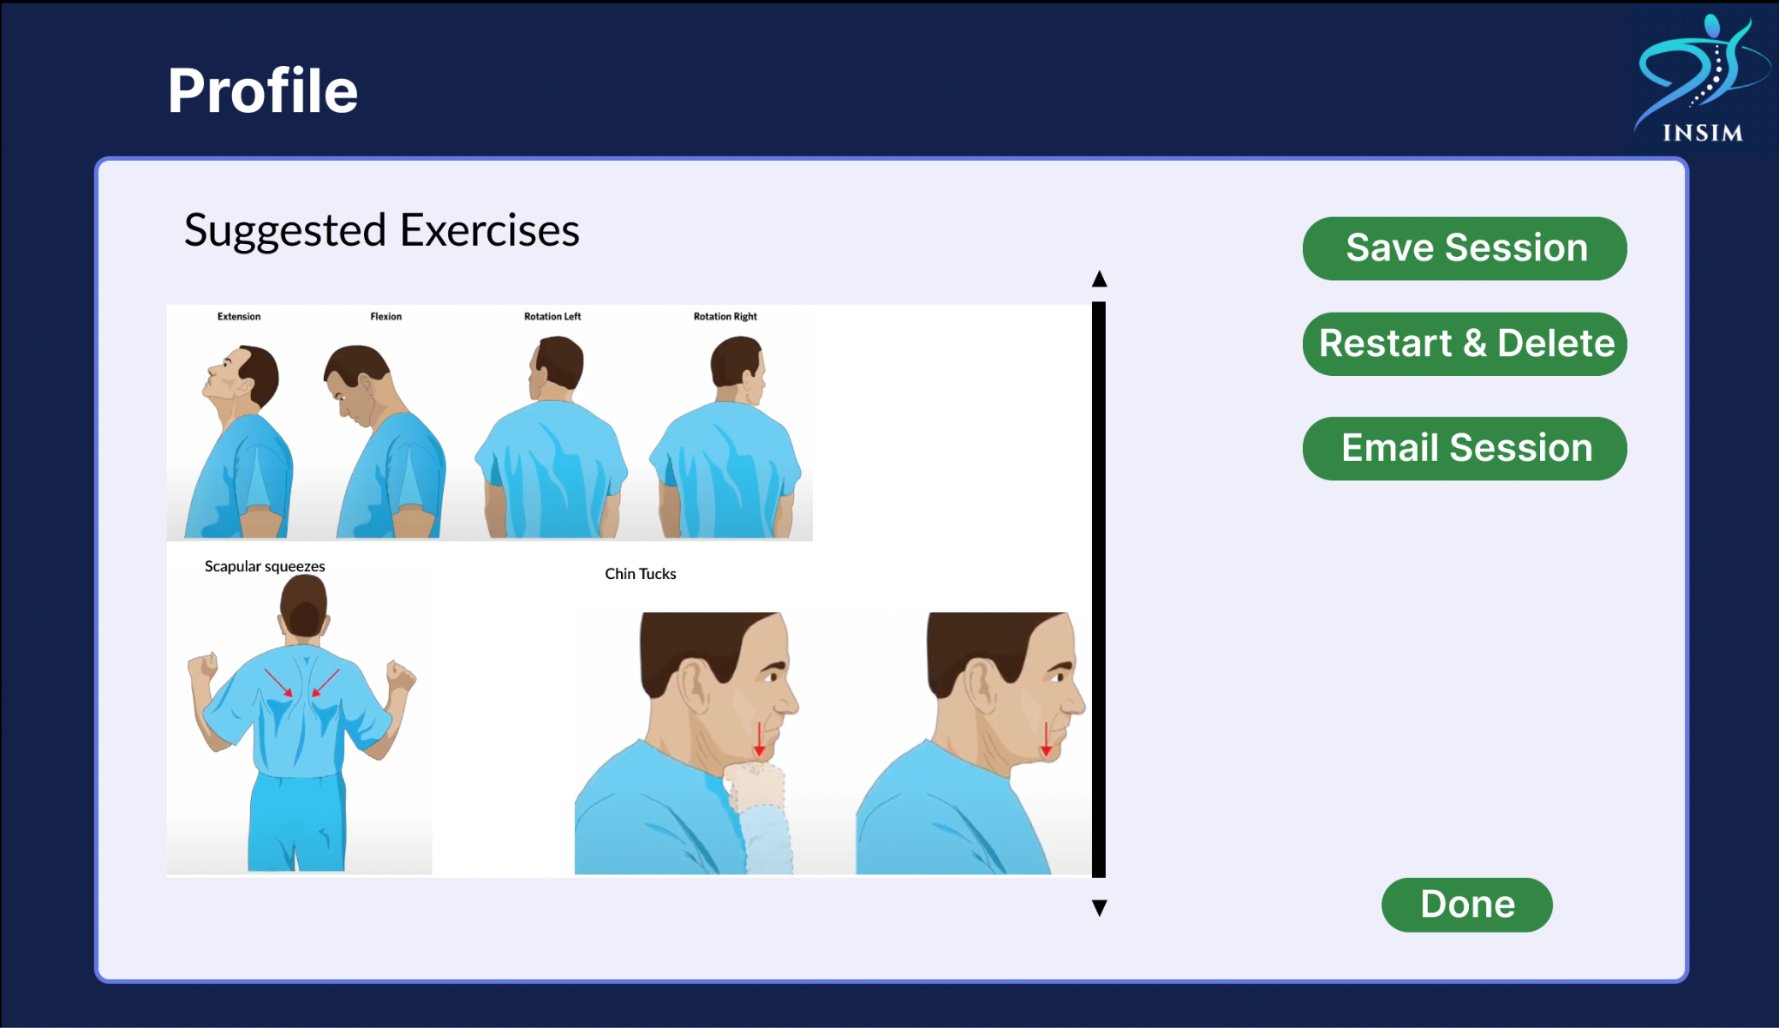
Solution

Slide 5
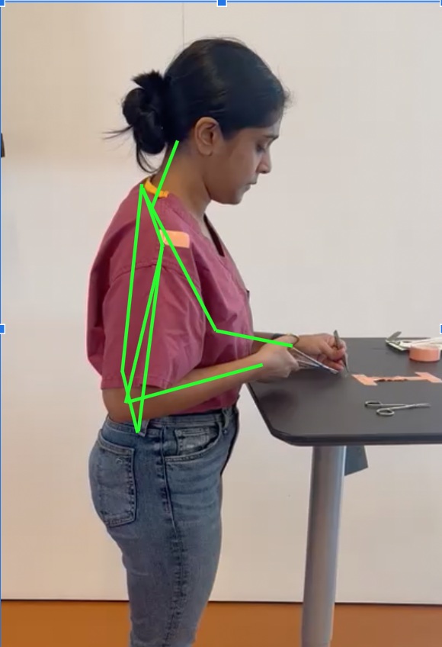
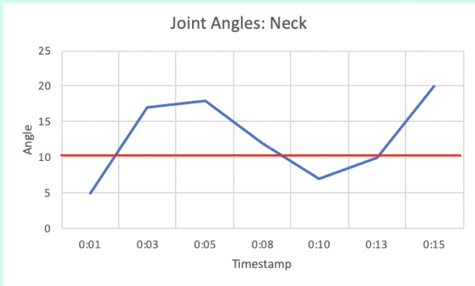
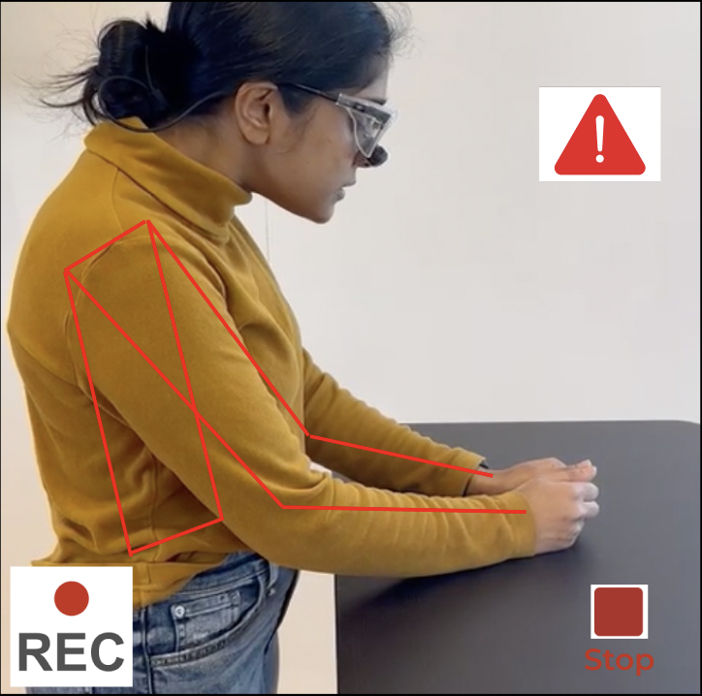
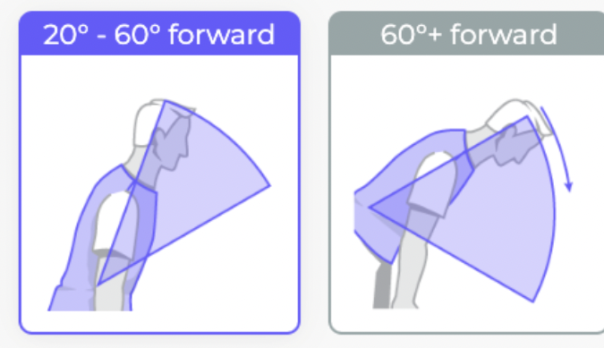
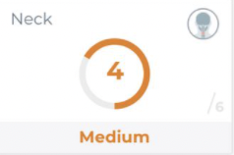
How InSim Breaks Down The Problem
Instant visual feedback during surgery that prompts surgeon to correct posture
Measuring bad posture, report generation for further work with PT and AI recommended everyday stretches

Slide 6
Customer Archetype & Value Proposition
Stakeholders | Value Propositions | Delivering Value
Hospitals | Reducing $15M (per hospital) loss due to surgeon absence Monitoring Learning Progress | By reducing workplace MSDs (surgical setting)
Surgical Residents | Career Longevity Improved Quality of Life Personalizable Non-Disruptive | Real-time posture correction specific to surgical tasks
Insurance Companies | Reduced MSD related Disability Claims | MSD Preventative Training for surgeons

Slide 7
Market
Total Addressable Market (Health and Wellness¹):
$450 Billion
Market Analysis (USA)
Target Market: Surgical Education and Training
Target Population: Medical Students, Residents
Funding: Chief Medical Officer; Med-Simulation Education
Penetration Rate: 10%
Serviceable Addressable Market (Posture Correction for Healthcare workers^{2,3}):
$9B
Serviceable Obtainable Market (10% Penetration Rate):
$900 Million
Straits Research. (n.d.) Wearable Fitness Trackers Market. Straits Research. Available at: https://straitsresearch.com/report/wearable-fitness-trackers-market (Accessed: 26th April 2023) McKinsey & Company. (n.d.) Feeling Good: The Future of the $1.5 Trillion Wellness Market. McKinsey & Company. Available at: https://www.mckinsey.com/industries/consumer-packaged-goods/our-insights/feeling-good-the-future-of-the-1-5-trillion-wellness-market (Accessed: 26th April 2023)
SAM estimated 1.8% adults are surgeons (https://www.statista.com/statistics/209424/us-number-of-active-physicians-by-specialty-area/), approximately 45% Posture market = Adults (from above report)

Slide 8
Business Model: B2B and B2C
Subscription Based Model
Target Market: Surgical Education and Training
Target Population: Medical Students, Residents
Business Model: Subscription Based
Price/Product: $350
Penetration Rate: 10%
INDIVIDUAL | $1,000 per year
TEAM (For 10-24 members) | $10,000 per year for 10 members +$500 per additional member
TEAM (For >=25 members) | $17,500 per year for 25 members +$300 per additional member
Revenue Model:
Subscription for Software
Maintenance ($5,000 per year)

Slide 9
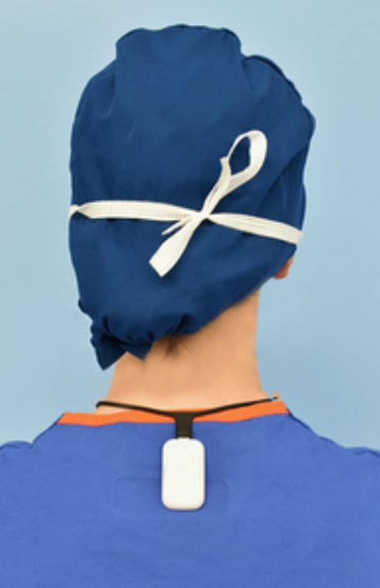
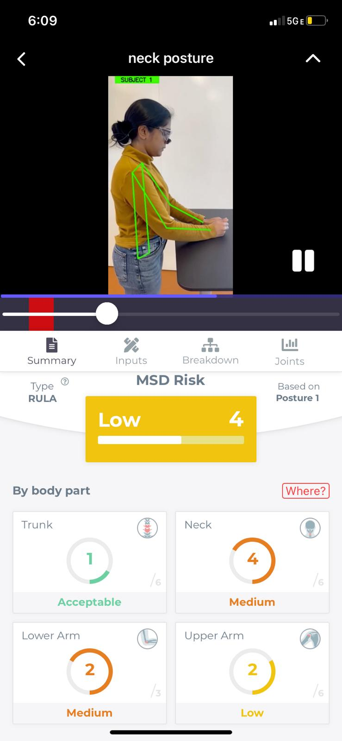



Competition
Upright Go
Our Design
Non-disruptive
Targeted Training
Surgeon-Specific
Data Metric for Hospitals

Slide 10


Go-to-Market Strategy: Regulatory Pathway
FDA Designation:
DeNovo Class 2 Medical Device (Software as Device)
HIPAA Regulation:
Data Privacy and Security

Slide 11


Go-to-Market Strategy: Distribution Channels
Target Market: Surgical Education and Training
Target Population: Medical Students, Residents
Business Model: Subscription Based
Price/Product: $350
Penetration Rate: 10%
Phase 1: Through Simulation Center
Simulation centers are a location or sometimes an event* where surgical residents and interns learn to perform the surgery.
*Teaching hospitals have specialized locations while in other hospitals surg-tech companies demo and teach surgeons to use their products
Phase 2: Software as a Service
Have InSim’s AI offering in every surgeon’s device to monitor their posture during and after surgery

Slide 12
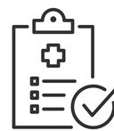

Go-to-Market Strategy: Partnering is Key!
Industry and Commercial:
Med-tech companies focused in surgical ergonomics like Intuitive, J&J
Workplace insurance companies for hospitals
Surgical Ergonomists
Aim to make InSim the top measuring tool for good ergonomics with devices and postures
Clinical Bodies:
Mayo Clinic is a pioneer in the US for surgical ergonomics
ACS (American College of Surgeons)
ACGME (American Council for Graduate Medical Education)
Aim to make ‘good posture’ a training metric for surgeons.

Slide 13
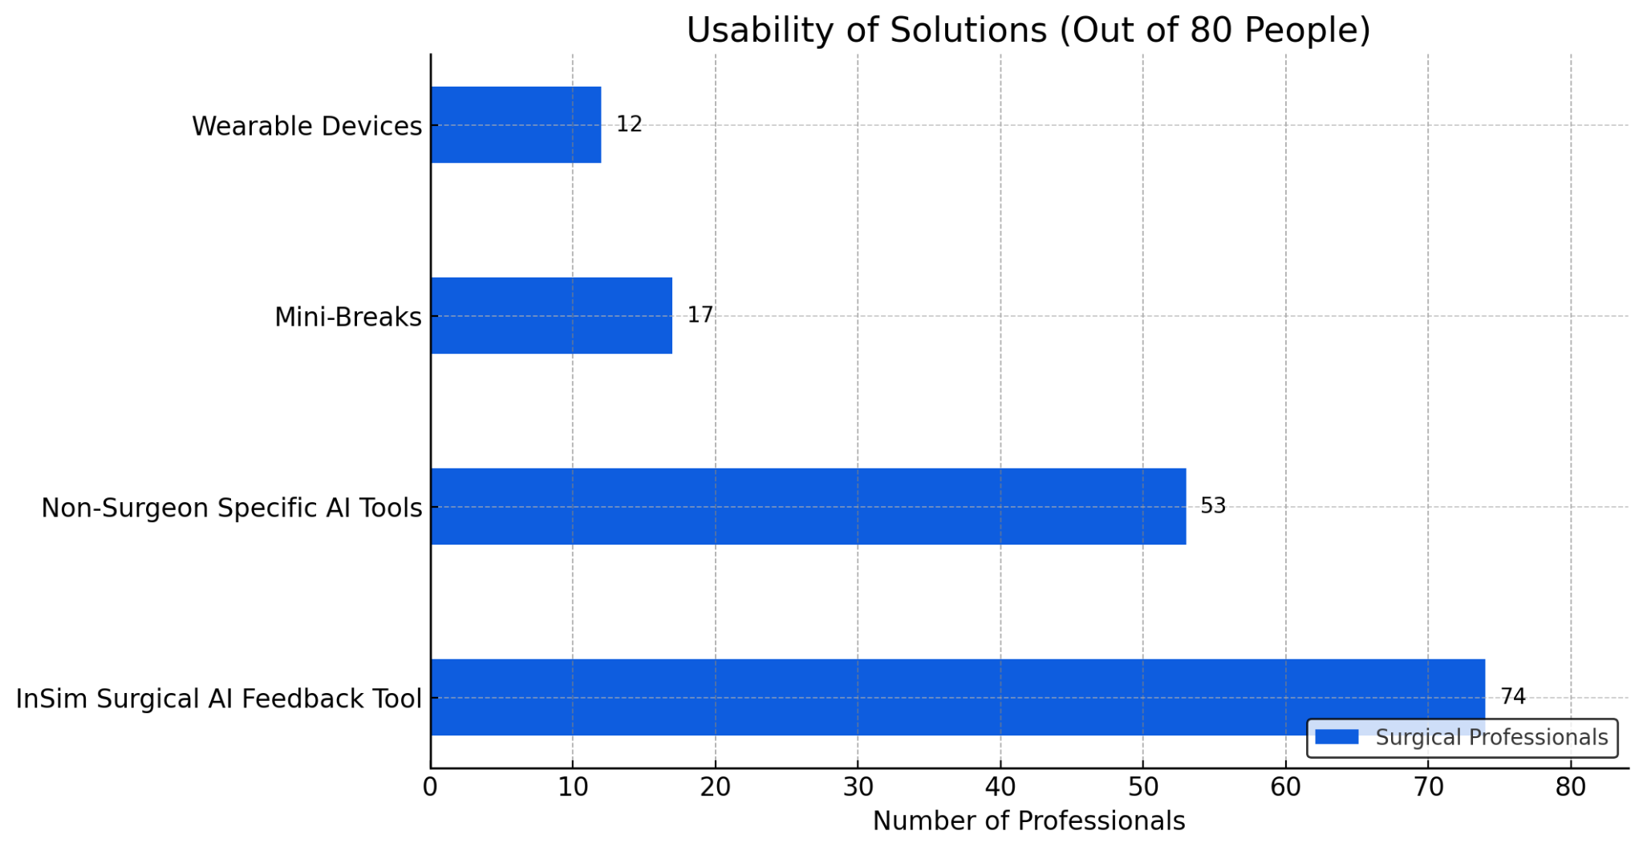
Defining Success Metrics: “Usability”
How easy do surgeons find it to use solution? How much set up is required? Ease of remembering and adopting solution in OR.
Phase 0 results
(based only on a voluntary workshop with InSim Surgical AI Software pre-scaling)

Slide 14
Defining Success Metrics: Future Phases
In the upcoming phases using a mix of quantitative and qualitative data is vital. This also forms the basis for the Pre-Market Approval (PMA) submissions.
Quantitative:
Frequency of use
Improvement in Posture over Set period (for an X population)
Improvement in clinical outcomes
Qualitative:
Ease of Use
Perceived Effectiveness

Slide 15
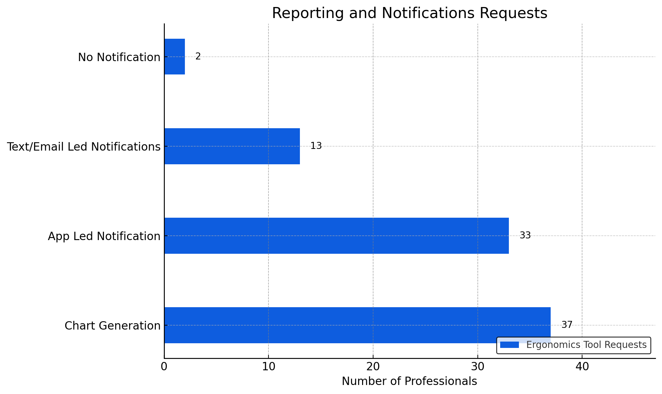
Iterative Device Improvement: to Phase 1
Using principles of Human Centered Design to understand “what do the users want” in the device.
Notifications were a key concern for surgeons and residents due to the amount of “distractions” and “disruptions” in their schedule.
How to Get Our attention: By surgeons and residents of Presbyterian, Phase 0
(based only on a voluntary workshop with InSim Surgical AI Software pre-scaling)

Slide 16
Next Steps (6 month goal)
File For IRB
Scale For 1000 Users At Columbia Presbyterian for PMA
Build Data Privacy And Security Modules
Onboard established connections at Mayo Clinic and ACE
Keep Iterating! Keep Talking to Stakeholders

Slide 17
Thank you!

